Slide 1

Lecture – 10/4/2016
CSCI 36300 – Software Design

Slide 2
Assignment #2 – Feedback

Slide 3
Assignment #2 – Phase II
Submission Due:
10/7/2016 11:59 PM
Master Branch
Ensure that Myself, the TA, and the Grader are added as contributors to your Repo.
Make sure you address each of my comments with the following:
// Fixed: <explanation on how you addressed my comment>

Slide 4
Quiz #7

Slide 5
Principles of Rotten Design
Four Symptoms of Rotten Design:
Rigidity
Fragility
Immobility
Viscosity
Each of these symptoms is related to one another – but it may not always be clear.
It is our job, as software engineers, to be able to identify these and handle them accordingly.

Slide 6
Rigidity
The tendency for software to be difficult to change.
This can be the case with even the simplest of systems.
Cascading effects – one small change has a ripple effect on the rest of the system.
Fear, Panic, Packs of Wild Dogs Taking Over…

Slide 7
Fragility
The tendency of the software to break in many places every time it is changed.
Often this break occurs in an area that should, conceptually, not even be related to the implemented change.
Fear if we make one change that we will introduce countless other errors – trust is lost and as a result we lose creditability.

Slide 8
Immobility
The inability to reuse software from other projects or from parts of the same project.
We stress code reuse for a reason – if we write all this “silo” code that we cannot reuse then we are not maximizing our productivity and efficiency.
We see something similar but don’t want to use it because it doesn’t work how “we” think it should, so we rewrite rather than reuse.

Slide 9
Viscosity
Two Forms:
Design
Environment
Viscosity
Difficulty to implement the necessary, but often hard.
“It is easy to do the wrong thing, but hard to do the right thing.”

Slide 10
Viscosity
Design
More than one way to make the necessary change or implementation.
What do we do – the easy or the right?
Preserve the design vs. a simple hack
Management pressure?
The boss NEEDS it done yesterday, what should we do?

Slide 11
Viscosity
Environment
When the development environment is slow and inefficient.
Example:
Compile times are long – make changes that prevent the need for large recompiles.
GitHub, MPC, Valgrind, etc…

Slide 12
Principles of Rotten Design
What causes this rot – why do we see our software designs rot?
Changing Requirements
We as software engineers know that people change their mind – therefore the most volatile of all software artifacts is the requirements specification.
How can we make our designs resistant, or tolerable, of these changes?

Slide 13
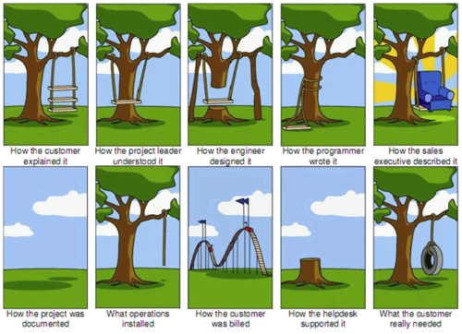

Slide 14
Principles of Rotten Design
Dependency Management
What kind of changes cause designs to rot?
Changes that introduce new and unplanned for dependencies.
The dependencies between modules in an application must be managed.
OO Design has many such mechanisms and techniques for managing this process – hence why we are taking this class! ☺

Slide 15
Rotten Design – Two Phases
Active Rot
Continuous changes in the code.
Lose integrity over time.
New Requirements = New Bugs
Dormant Rot
Unused software the primary cause.
Possibly from a failed implementation.
Customer changed their mind.
Found a better way but did not clean up after ourselves.
Etc.

Slide 16
Principles of OO Class Design

Slide 17
Principles of OO Class Design
What makes good OO Class Design?
We know this class is focusing on this but how do we achieve this?
Patterns & Principles
So lets start exploring this world so we can find out how to write “good” software.
We begin with a high-level overview…

Slide 18
Open Closed Principle

Slide 19
The Open Closed Principle (OCP)
“A module should be open for extension but closed for modification.”
-Bertrand Meyer
What does this mean?
We should design and write our code such that our various components can be reused without the need for modification.
Change the behavior and not the source code.

Slide 20
The Open Closed Principle (OCP)
That instantly sounds very abstract and generic – similar to the goal of what we were talking about with templates/generics.
How does this impact us?
Should our source code need to change each time a requirement changes?
Can we write source code such that if the requirements change the impact is minimal and no changes are needed?

Slide 21
The Open Closed Principle (OCP)
How do we achieve this in practice?
Inheritance & Polymorphism
Let us briefly revisit the discussion on those concepts….
Ok…
So where does that leave us in terms of understanding this principle?

Slide 22
The Open Closed Principle (OCP)
Simple Example:
Rectangle Class
Height
Width
Now we want to calculate the area of the rectangle.
Area Class
calculateArea(Rectangle)

Slide 23
The Open Closed Principle (OCP)
Requirements Change!
Now we also want to operate on Circles, Triangles, etc.
How do we adjust to meet this need?
Well, we could simply modify our code to include a check for the specific shape.
This would not abide by the OCP – in that our Area class is not closed for modification.

Slide 24
The Open Closed Principle (OCP)
Why not use inheritance to achieve this for us.
We already did that – and now we see the benefits to taking such an approach through the use of OCP.
We have closed it for modification but have opened it for reuse/extension.
Potential dangers?

Slide 25
The Open Closed Principle (OCP)
When should we apply this principle in practice?
How do we know requirements will change?
Well…we know they will – but how do we predict which ones will?
How much benefit is there versus the cost occurred for providing such functionality?
Tradeoff
Can you think of a reason why we wouldn’t want to abide by this principle here in this example?

